Slide 1
RCSI Acute Hospital Review Inpatients & Outpatients
January 2023

Slide 2
Table of Contents
Topic | Slide No.
Inpatient
IP & DC Discharges | 3
AvLOS Tables | 11
AvLOS Charts | 18
7-Day & 28-Day Readmission % | 29
Outpatients
Outpatient Activity | 34
2

Slide 3
Inpatients inpatient and daycase discharges
3

Slide 4
Comment
The following series of inpatient and daycase charts are based on HIPE data.
This data is generally two months behind the focus month of this monthly report.
Due to lags in coding of HIPE records, the latest reported month may be incomplete.
4

Slide 5
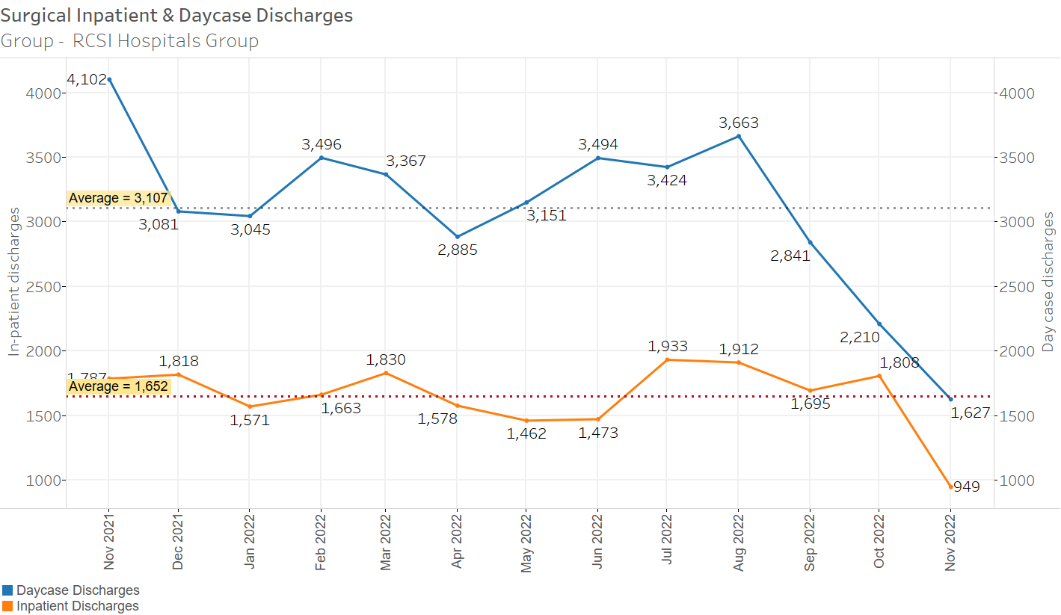
RCSI Surgical Inpatient & Daycase Discharges
5
Discharges in latest month may be understated due to incomplete data.

Slide 6
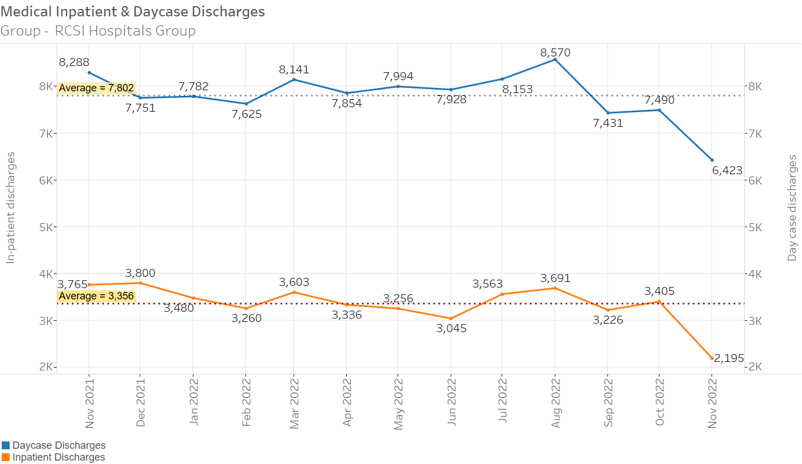
RCSI Medical Inpatient & Daycase Discharges
6
Discharges in latest month may be understated due to incomplete data.

Slide 7
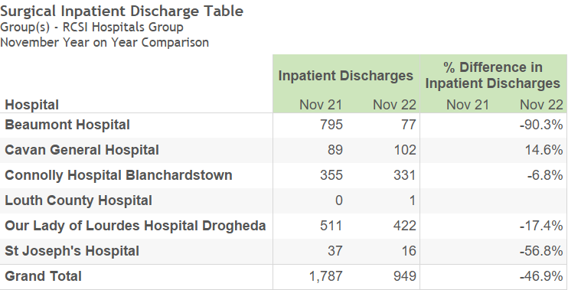
RCSI Surgical Inpatient Discharges
Discharges in latest month may be understated due to incomplete data.
7

Slide 8
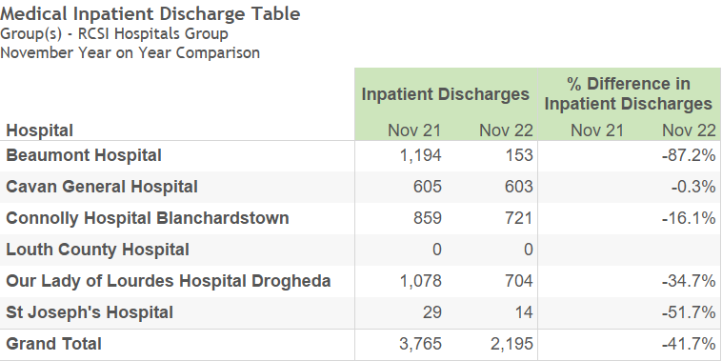
RCSI Medical Inpatient Discharges
Discharges in latest month may be understated due to incomplete data.
8

Slide 9
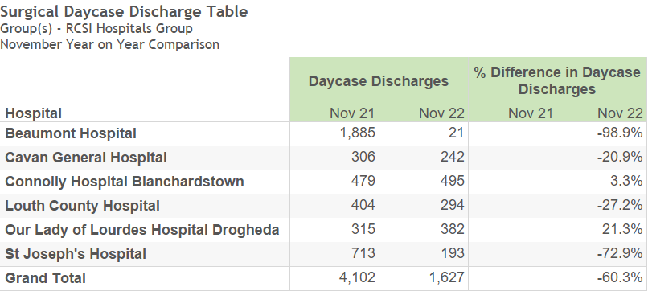
RCSI Surgical Daycase Discharges
Discharges in latest month may be understated due to incomplete data.
9

Slide 10
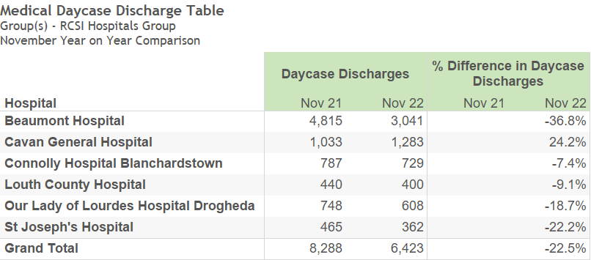
RCSI Medical Daycase Discharges
Discharges in latest month may be understated due to incomplete data.
10

Slide 11
Inpatients AVLOS Tables
Average Length of Stay (AvLOS)
AvLOS in latest month may be understated due to incomplete data.
Please note that the reported AvLOS is rounded to one decimal place, however, % difference is calculated using the unrounded figure.

Slide 12
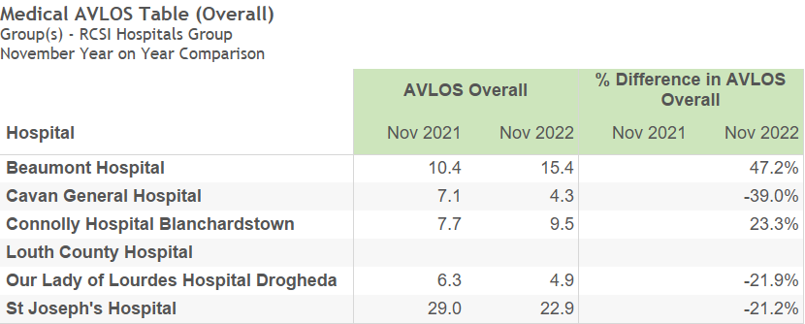
Medical AVLOS (Overall) 2022 v 2021
AvLOS in latest month may be understated due to incomplete data.
12

Slide 13
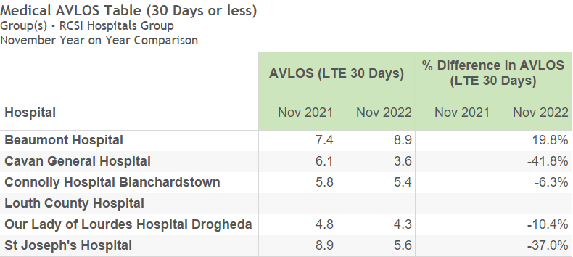
Medical AVLOS (30 Day Stay or less) 2022 v 2021
AvLOS in latest month may be understated due to incomplete data.
13

Slide 14
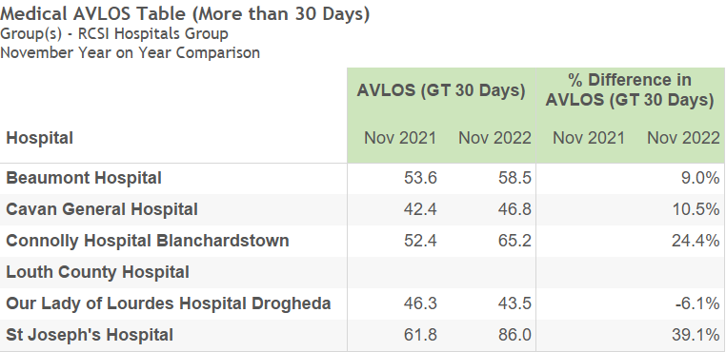
Medical AVLOS (More than 30 Days stay) 2022 v 2021
AvLOS in latest month may be understated due to incomplete data.
14

Slide 15
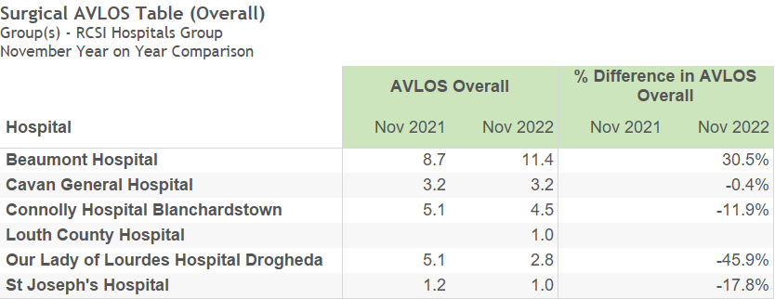
Surgical AVLOS (Overall) 2022 v 2021
AvLOS in latest month may be understated due to incomplete data.
15

Slide 16
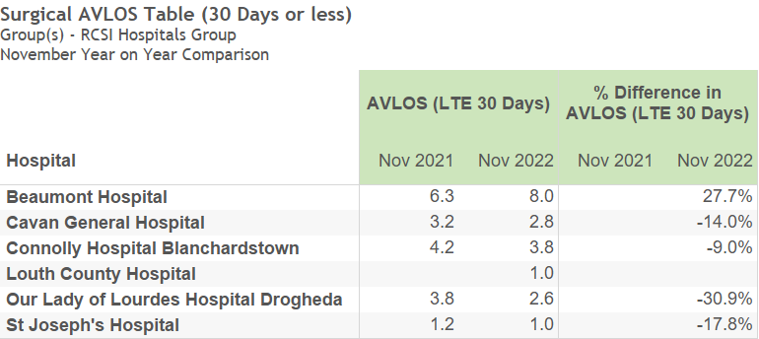
Surgical AVLOS (30 Day Stay or less) 2022 v 2021
AvLOS in latest month may be understated due to incomplete data.
16

Slide 17
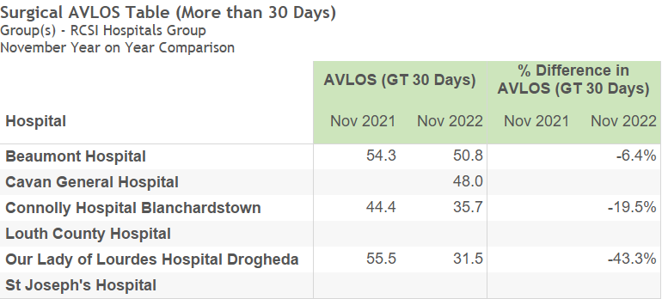
Surgical AVLOS (More than 30 Days stay) 2022 v 2021
AvLOS in latest month may be understated due to incomplete data.
17

Slide 18
Inpatients AVLOS Charts – Hospital Detail
18

Slide 19
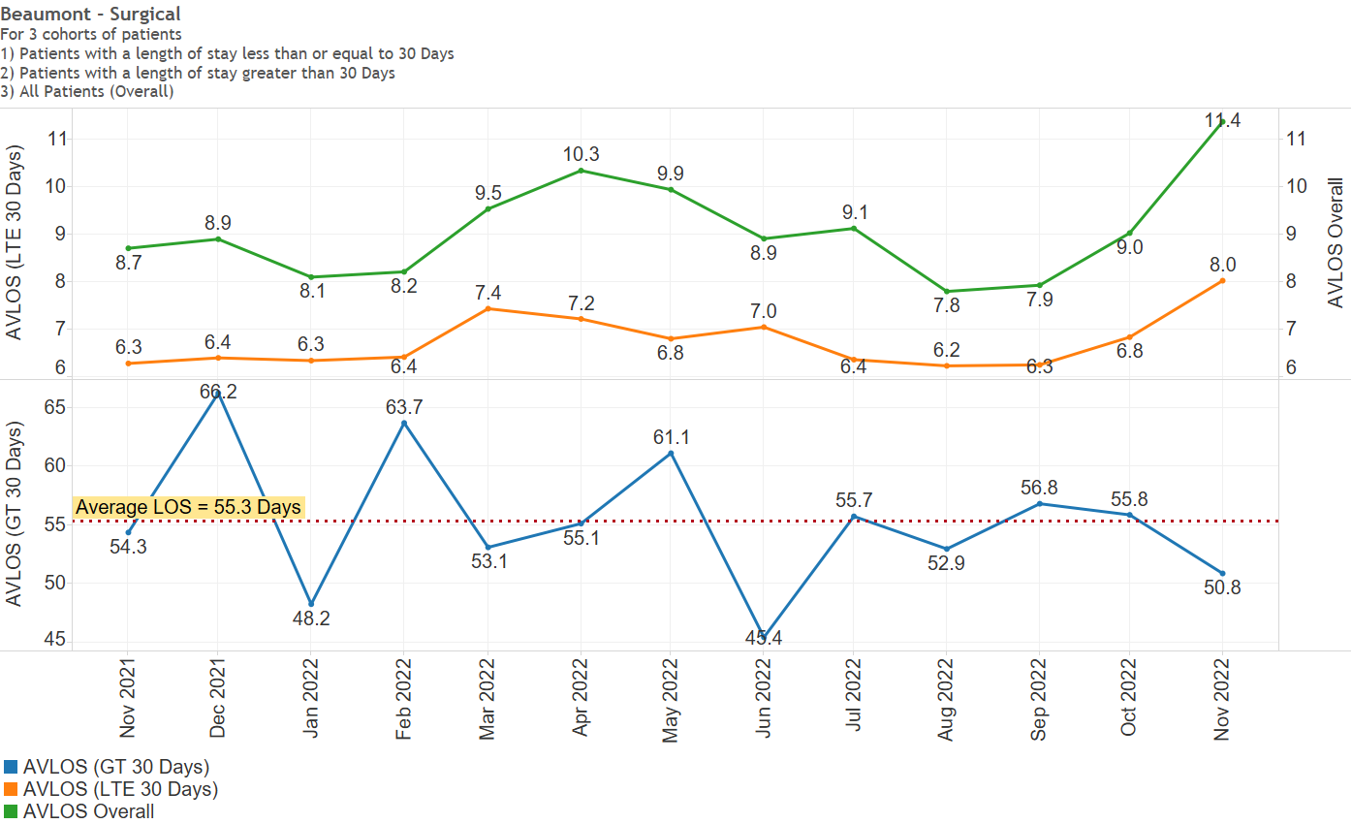
Beaumont - Surgical
AvLOS in latest month may be understated due to incomplete data.
19

Slide 20
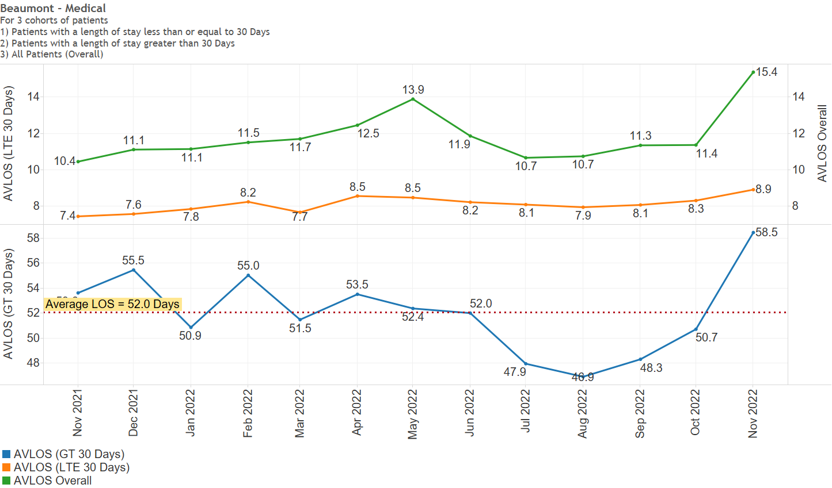
Beaumont – Medical
AvLOS in latest month may be understated due to incomplete data.
20

Slide 21
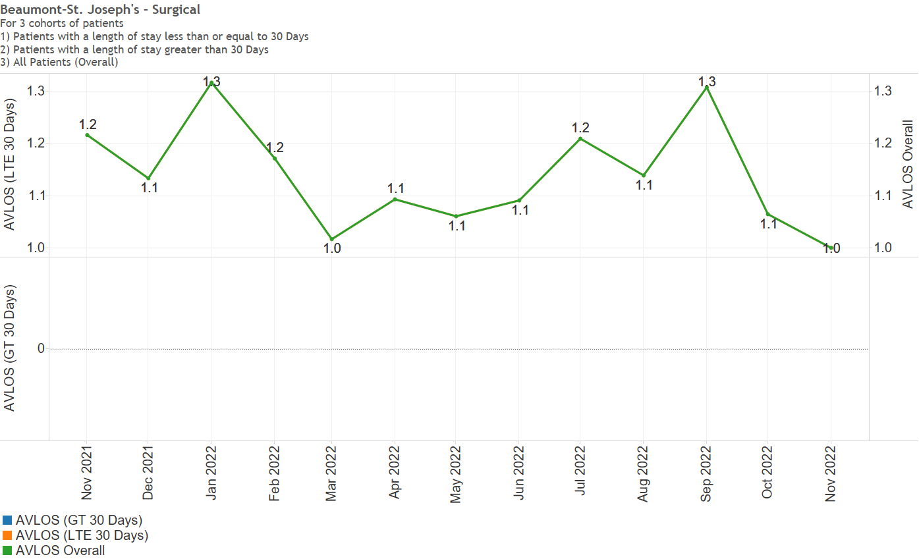
Beaumont-St. Joseph’s - Surgical
AvLOS in latest month may be understated due to incomplete data.
21

Slide 22
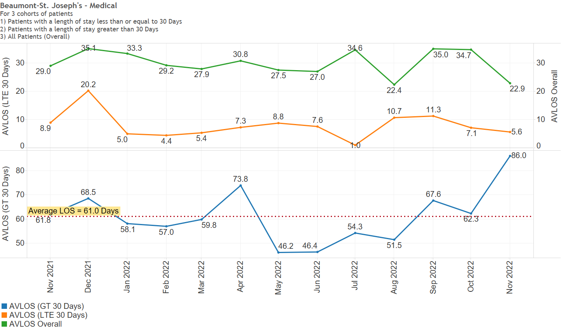
Beaumont-St. Joseph’s - Medical
AvLOS in latest month may be understated due to incomplete data.
22

Slide 23
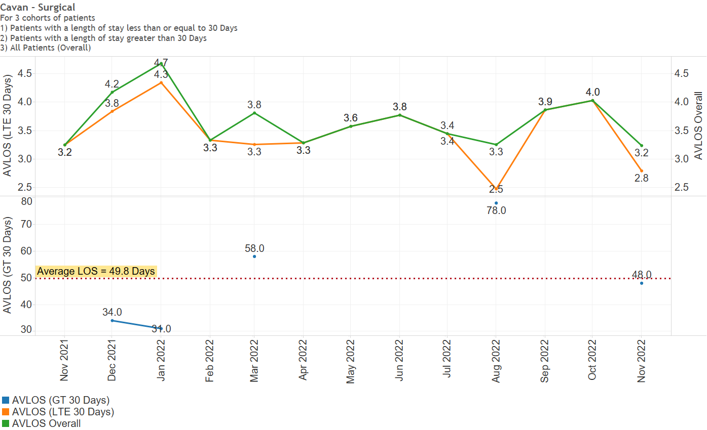
Cavan - Surgical
AvLOS in latest month may be understated due to incomplete data.
23

Slide 24
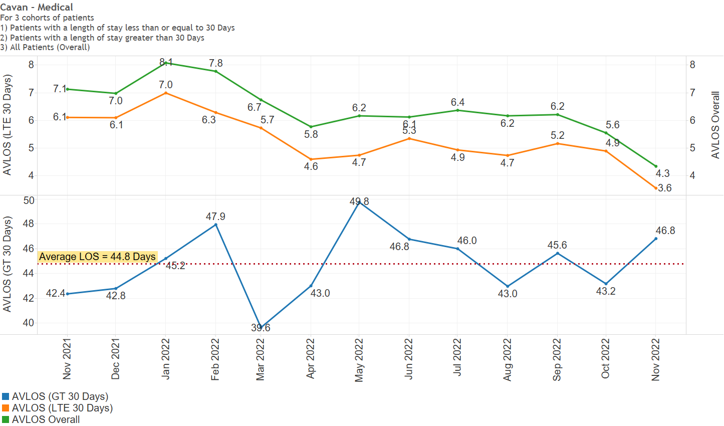
Cavan - Medical
AvLOS in latest month may be understated due to incomplete data.
24

Slide 25
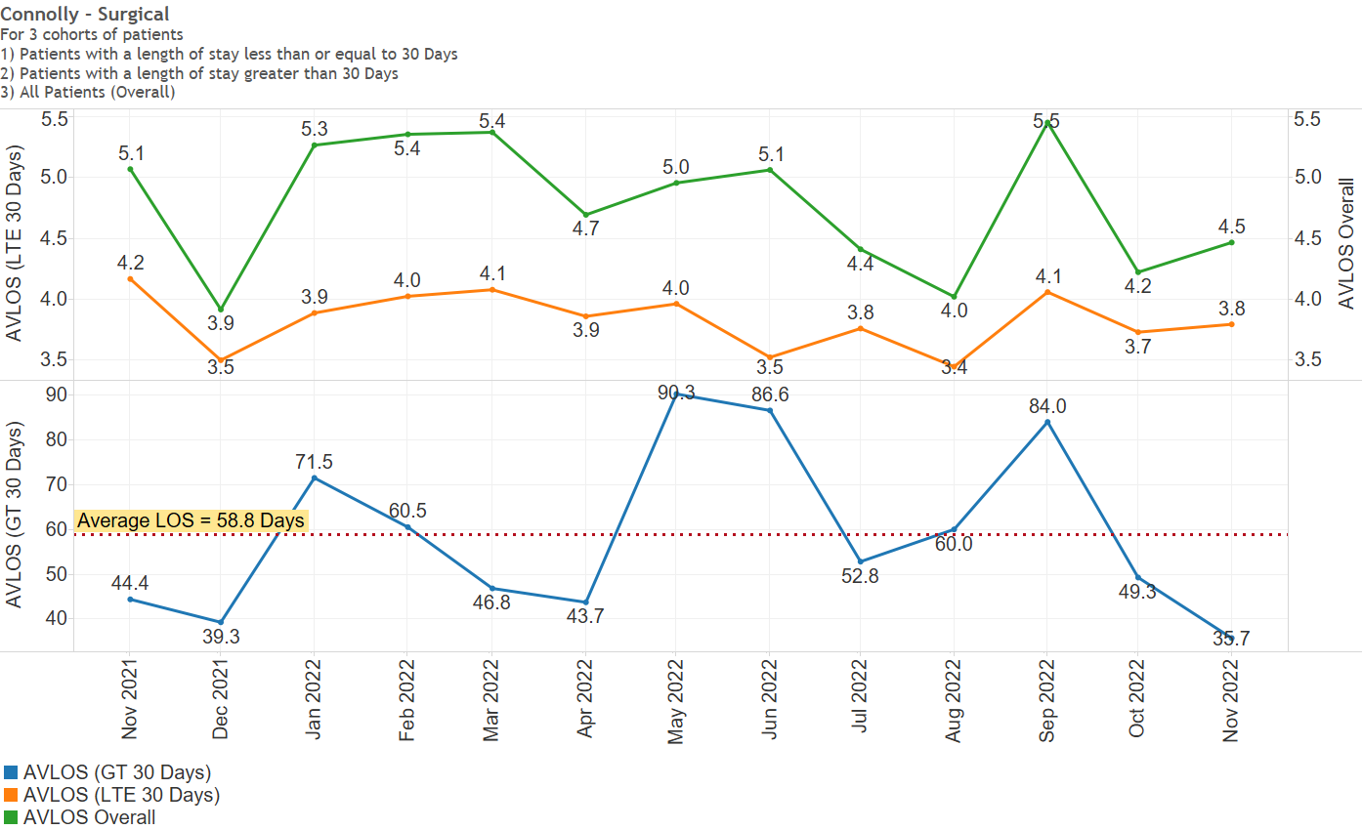
Connolly- Surgical
AvLOS in latest month may be understated due to incomplete data.
25

Slide 26
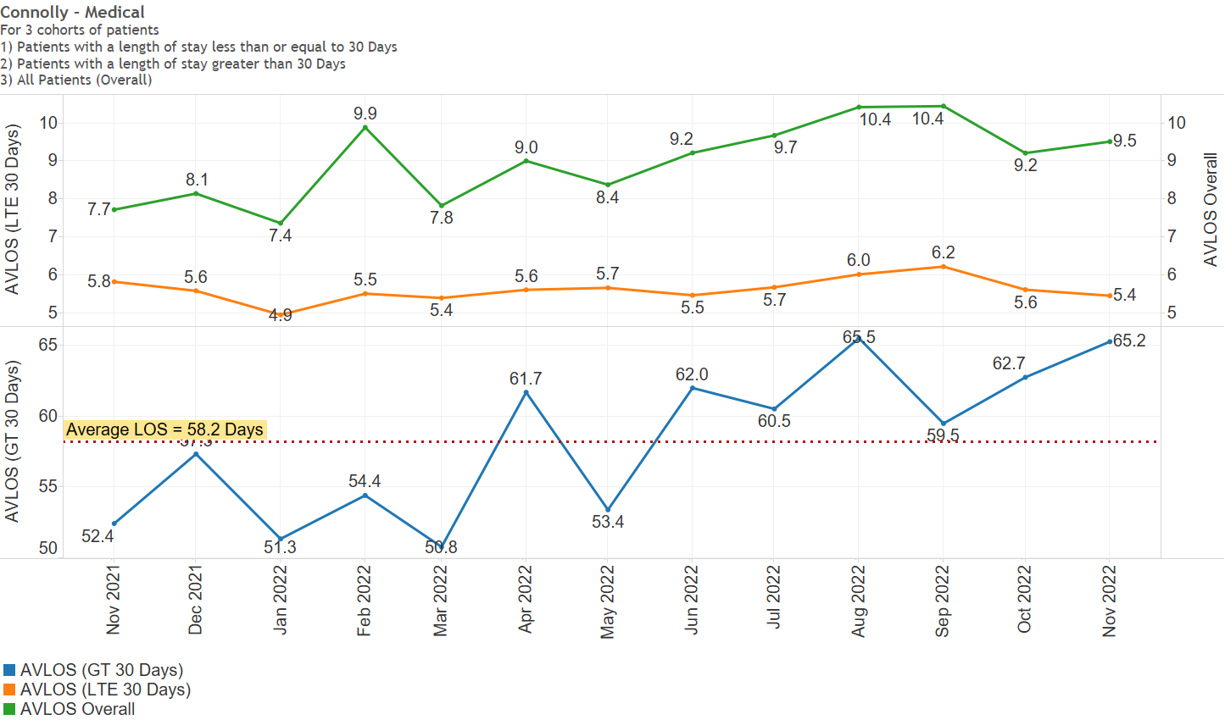
Connolly - Medical
AvLOS in latest month may be understated due to incomplete data.
26

Slide 27
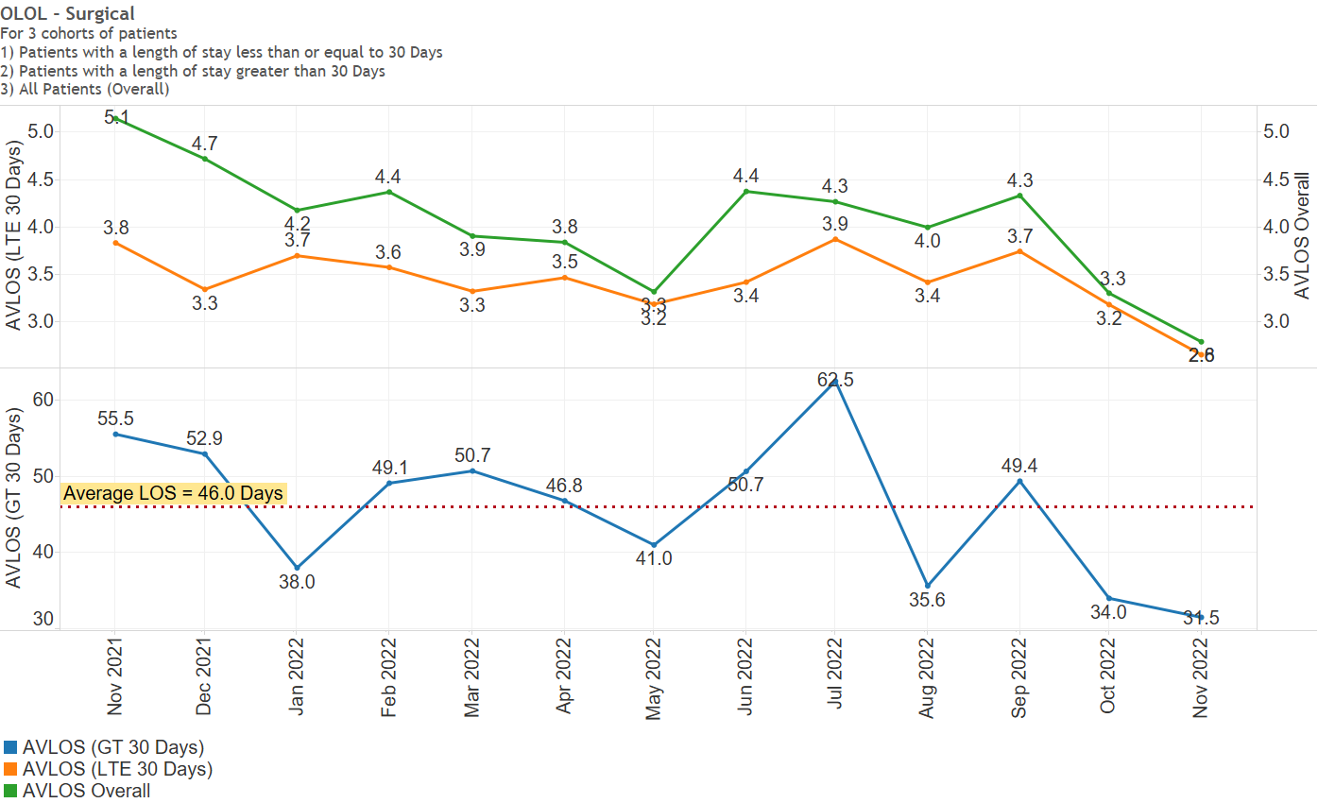
OLOL - Surgical
AvLOS in latest month may be understated due to incomplete data.
27

Slide 28
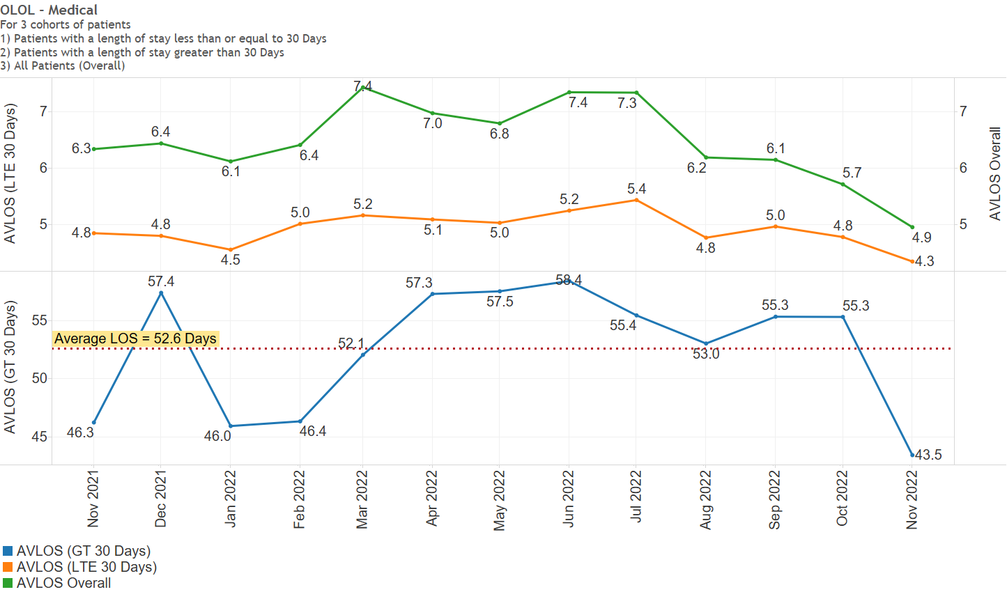
OLOL - Medical
AvLOS in latest month may be understated due to incomplete data.
28

Slide 29
Inpatients 7 Day & 30 day ReAdmission Percentages.
The N-day readmission rate is calculated as the fraction of emergency discharges in the reporting month of whom were readmitted to the same hospital in less than N days. It should be noted that until HIPE is updated with data for the next reporting month there will only be a portion of the actual count of readmissions for the current reporting month in the records as the patient is not recorded in HIPE until they are discharged, e.g. if a patient was discharged on 2019-01-28 and then readmitted as an emergency on 2019-02-03, there will be no information on the readmission until HIPE is updated for February 2019 and the reported readmission rate will be the fraction of January 2019 discharges readmitted before 2019-02-01 00:00:00; consequently the readmission rates for the latest reporting month are substantially understated.
29

Slide 30
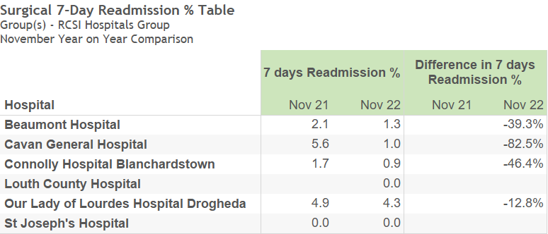
Surgical 7-Day Readmission %
Readmission rates in latest month may be understated due to incomplete data.
30

Slide 31
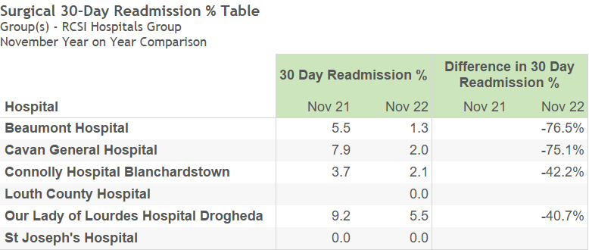
Surgical 30-Day Readmission %
Readmission rates in latest month may be understated due to incomplete data.
31

Slide 32
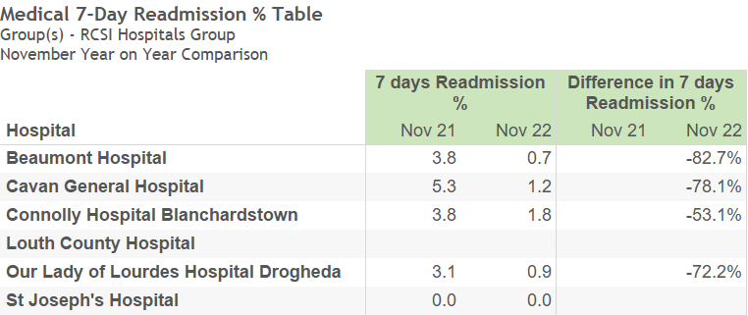
Medical 7-Day Readmission %
Readmission rates in latest month may be understated due to incomplete data.
32

Slide 33
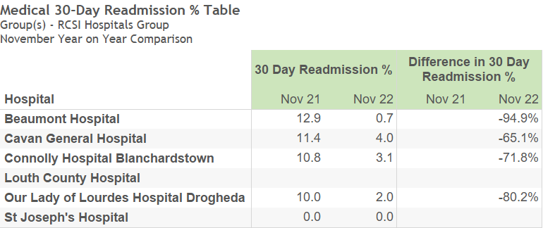
Medical 30-Day Readmission %
Readmission rates in latest month may be understated due to incomplete data.
33

Slide 34
Outpatients Activity
34

Slide 35
Comment
The data for Outpatient Activity is generally one month behind the focus month of this monthly report.
35

Slide 36
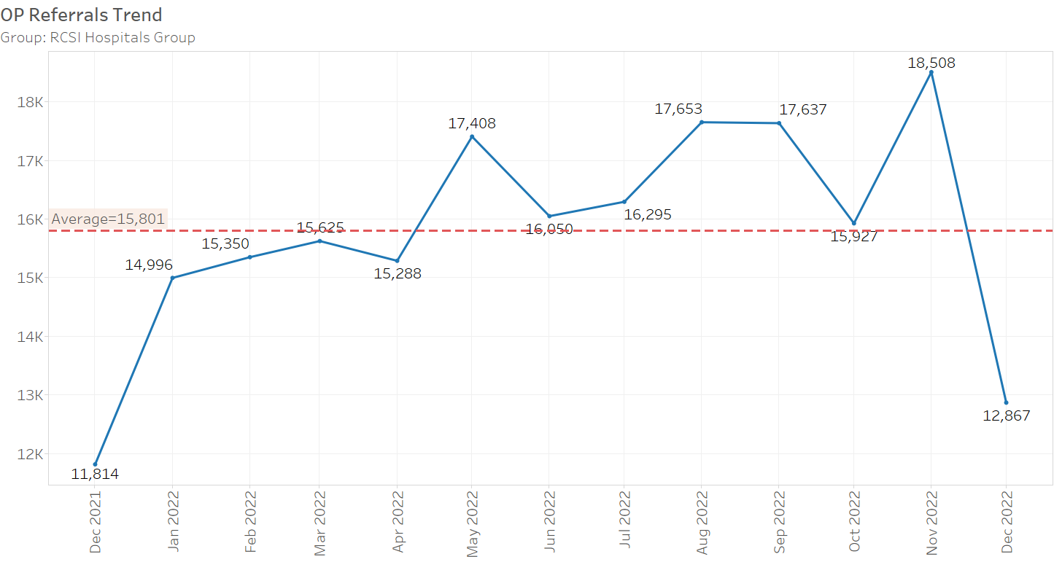
Monthly New Referrals
36

Slide 37
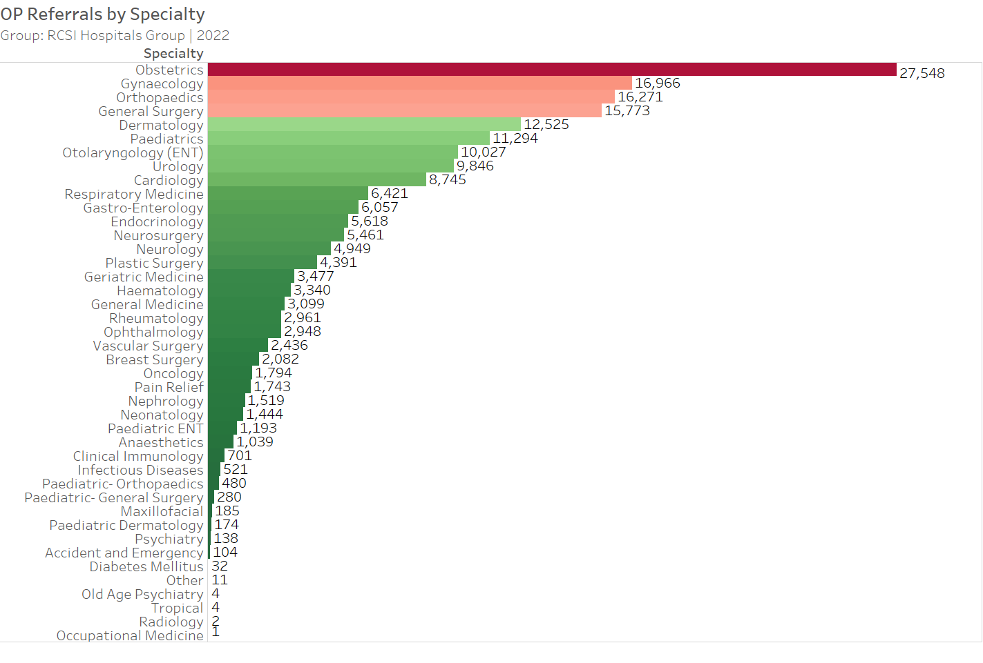
Year to Date Referrals by Specialty
37

Slide 38
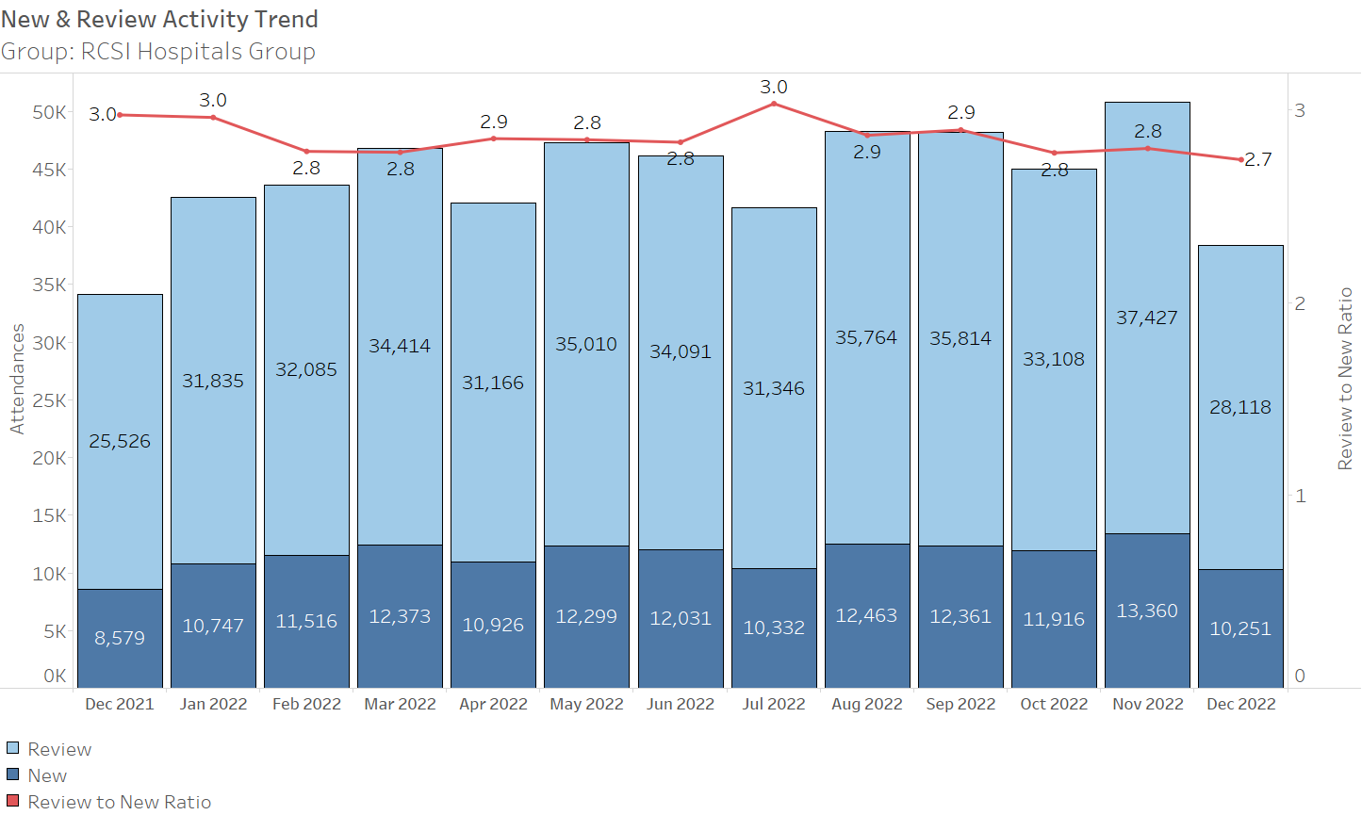
OP New & Review Appointments
38

Slide 39
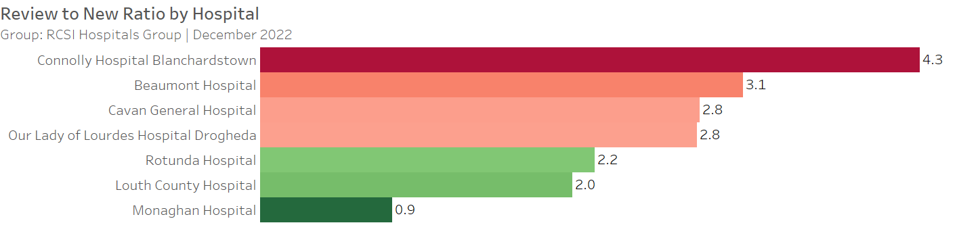
Review to New Ratio by Hospital
39

Slide 40
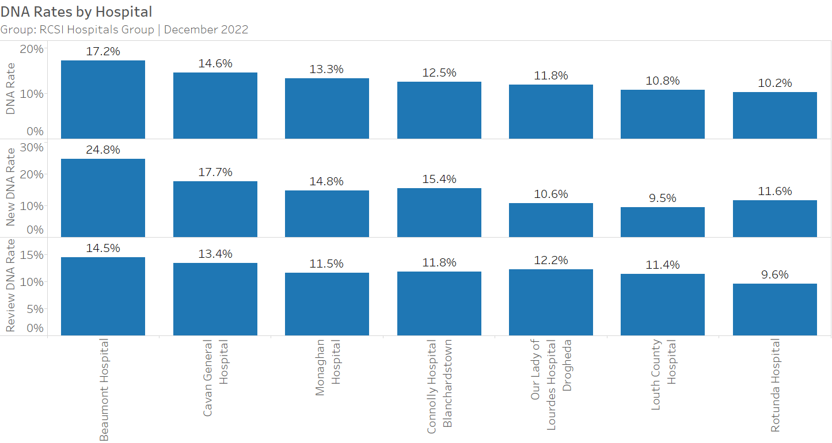
DNA Rates by Hospital
40

